Slide 1

Master Thesis
EMI Filter Design and Verification using RF Simulation Tools and Measurements
Md Moinuddin Biswas
Matriculation Number: 5071889
First Advisor: Prof. Dr. S. Peik
Second Advisor: Prof. Dr. Mirco Meiners

Slide 2
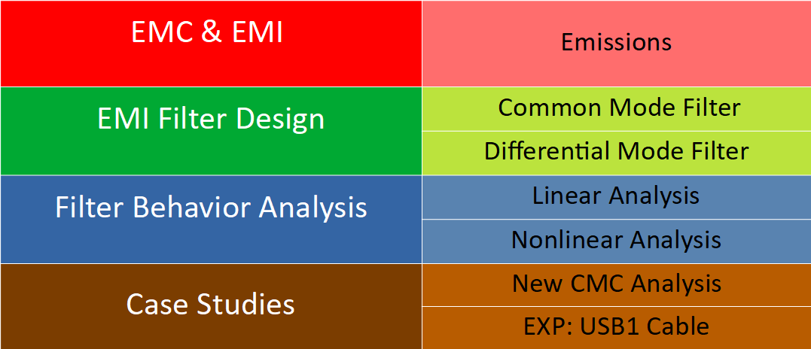
Contents

Slide 3
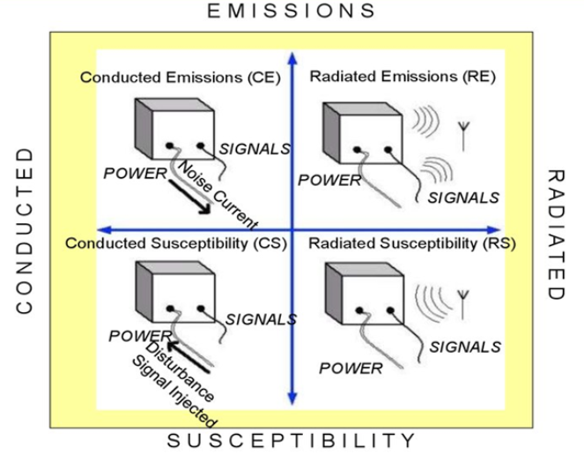
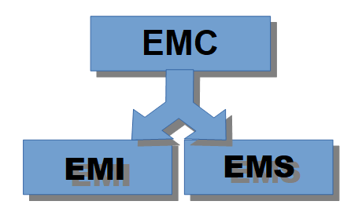
EMC & EMI
Figure 01: EMC classification.
Figure 02: Measurement relationship between EMC classes[1].

Slide 4
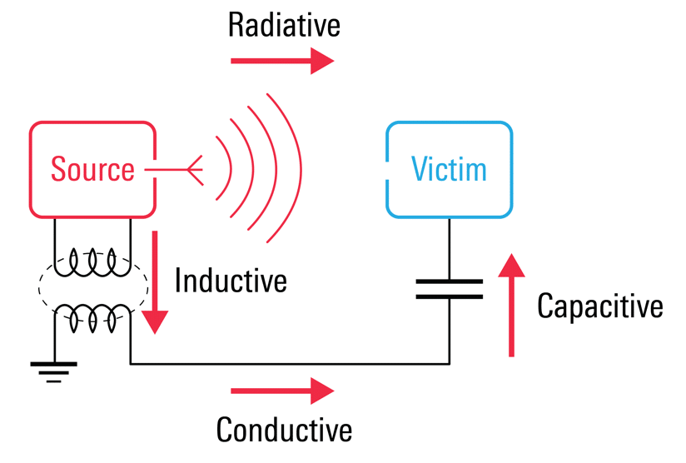
Emissions
Intentional or unintentional generation of electromagnetic energy by a source.
Inherent to the switching voltages and the currents within digital circuit.
Releases into the equipments just after generation through air or conductors.
Classified into categories before propagating
Conducted emissions are dispersed with the use of interconnecting cables.
Figure 03: Generation of two emissions [2].

Slide 5
EMI Filter Design
Suppress electromagnetic noise transmitted through conduction.
Extract unwanted current conducted through wiring or cables, while allowing desirable currents to flow freely.
Often acts like a low-pass filter that sift out high frequencies while letting lower frequencies pass through.
After the filtering process, electromagnetic noise gets diverted away from the device and to the ground.
Should not be installed too close to the source or to the load, or too far away from the power line.
Categorized based on its generation, duration and bandwidth.

Slide 6
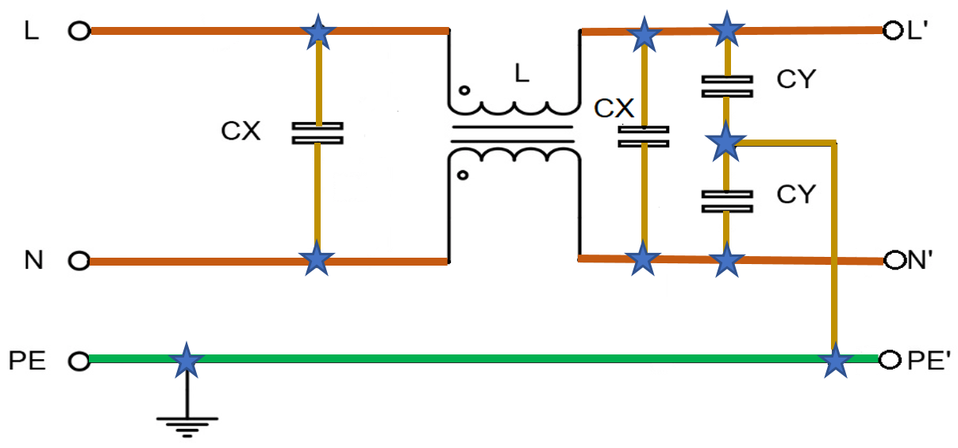
Design selection
Figure 04: Standard circuit design of an EMI filter [3].

Slide 7
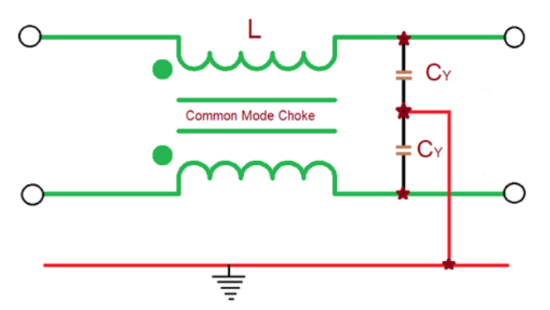
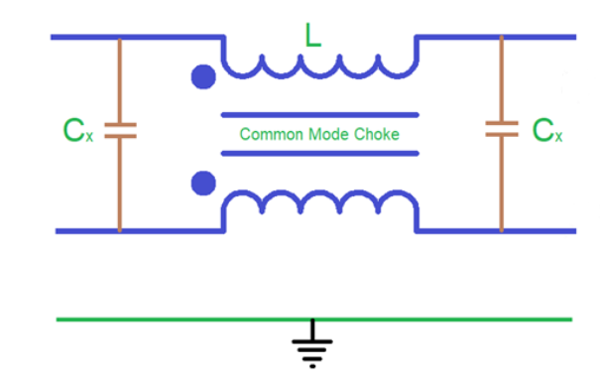
Design Category
An EMI filter is divided into two sub filters designed according to the generation of noise.
Common Mode Filter (CMF)
Differential Mode Filter (DMF)
Figure 05: Common mode part and Differential mode part in an EMI filter

Slide 8
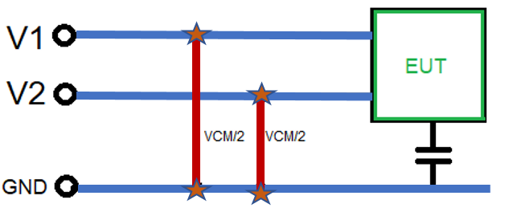
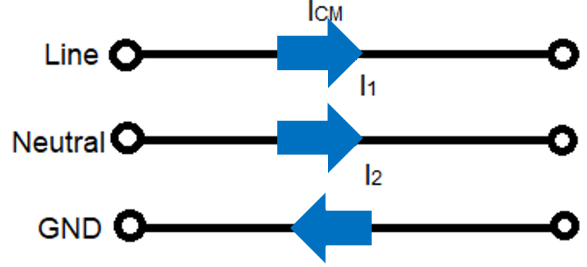
Common Mode Filter
A common mode voltage is an uneven and unbalanced voltage defined as the voltage between the conductor line and the ground, or as the mean of the phasor voltages appearing between each conductor and a specified reference, usually earth or frame.
V_{CM} = (V₁+V₂) / 2
The current of the common mode noise flows in the same direction through the power line and the neutral and returns through the ground conductor.
I_{CM} = I₁ + I₂
Figure 06: Voltage measurement of a Common Mode Filter.
Figure 07: Current flow path in a Common Mode Filter.

Slide 9
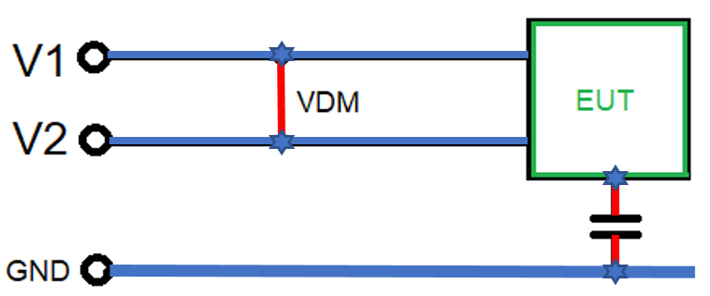
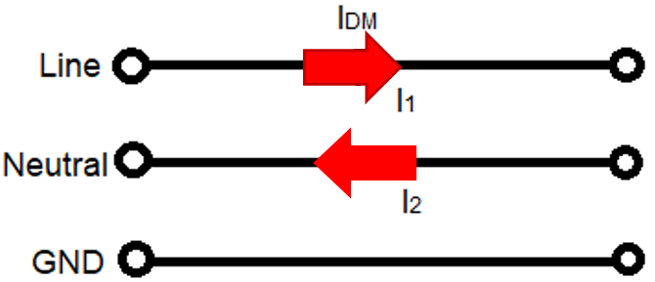
Differential Mode Filter
Differential mode is also known as normal mode or symmetrical mode. It has a balanced voltage that is generated in between the line and neutral wires. It is the difference of the voltages of line and neutral.
V_{DM} = V₁ – V₂
Differential mode currents flow in opposite directions and equal to the half of the vector difference of current that flows through line to neutral in cross-section area.
I_{DM} = (I₁ – I₂) / 2
Figure 08: Voltage measurement of a Differential Mode Filter.
Figure 09: Current flow path in a Differential Mode Filter.

Slide 10
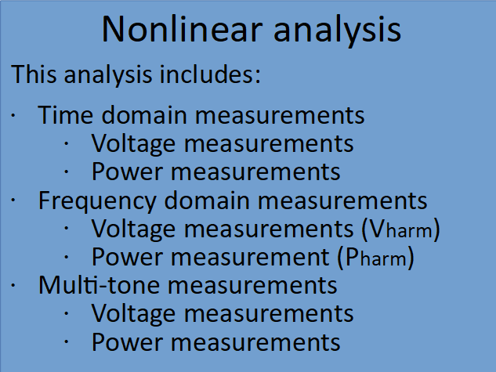
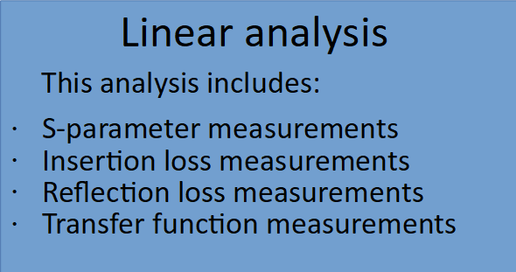
Filter Behavior Analysis
To predict the filter behavior, entire analysis is classified into two categories:

Slide 11
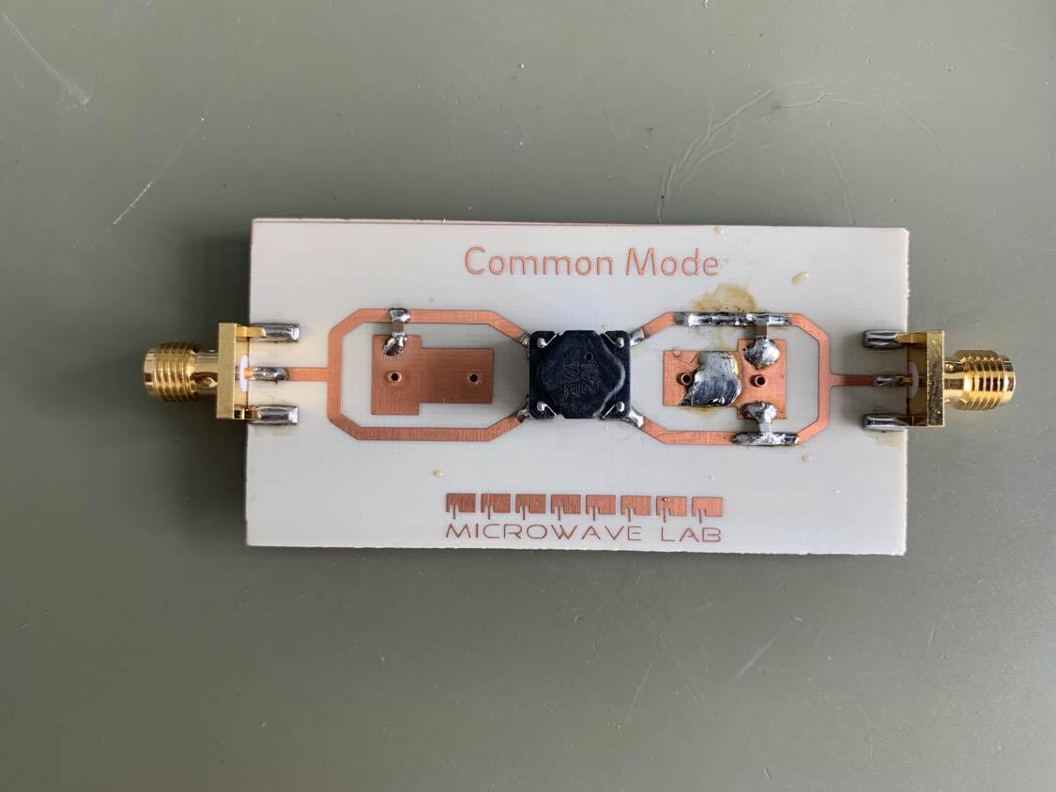
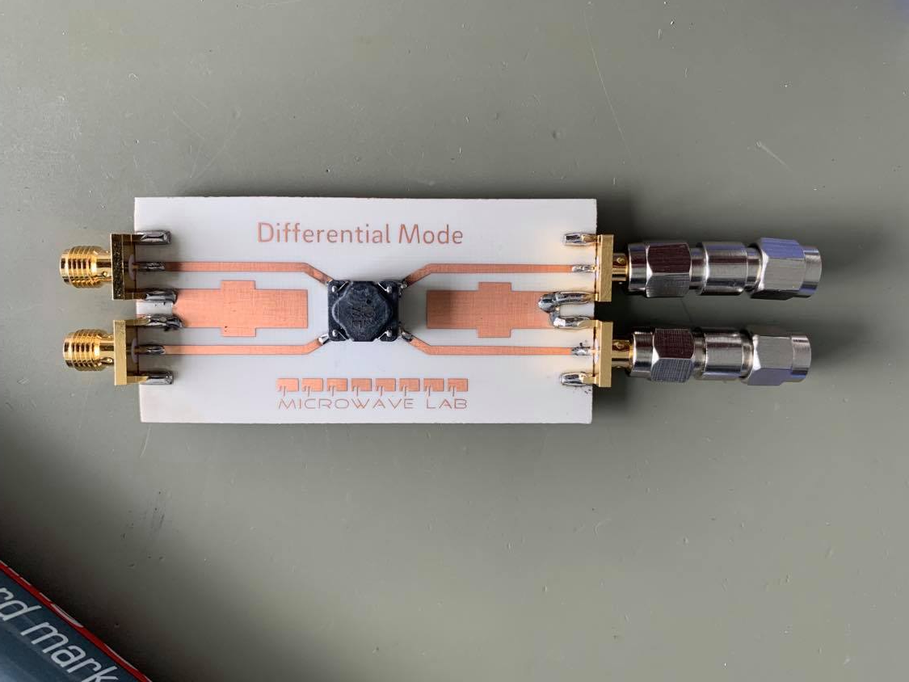
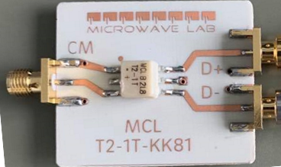
Linear Analysis
S-parameters: Scattering parameters (S-parameters) describe the electrical behavior of linear electrical networks when undergoing various steady state stimuli by electrical signals. From the circuit schematic this parameters can easily determined.
Figure 10: Hardware design (measured) of Common Mode Filter and Differential Mode Filter and Balun Transformer.

Slide 12
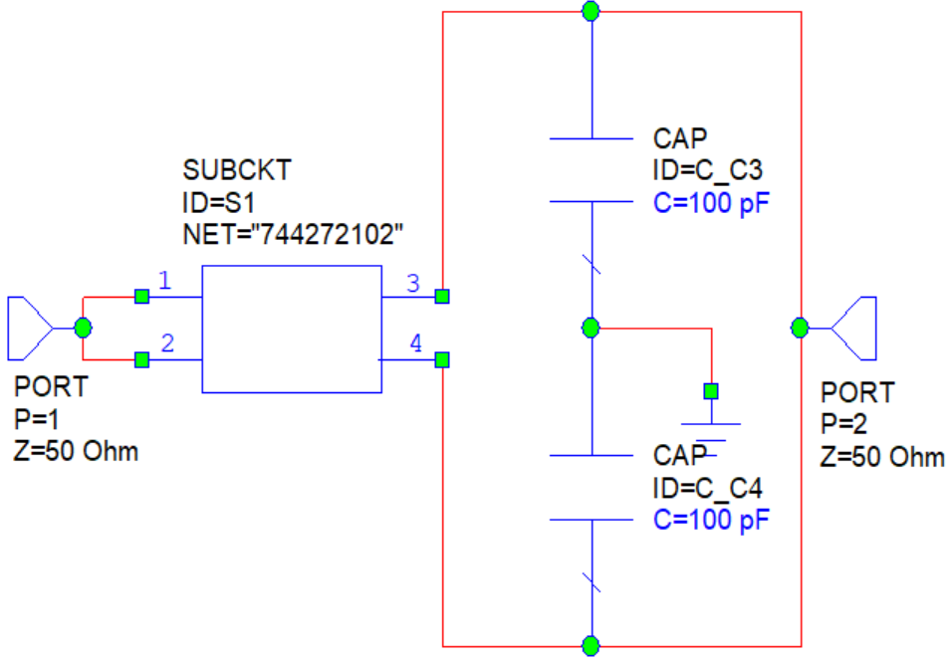
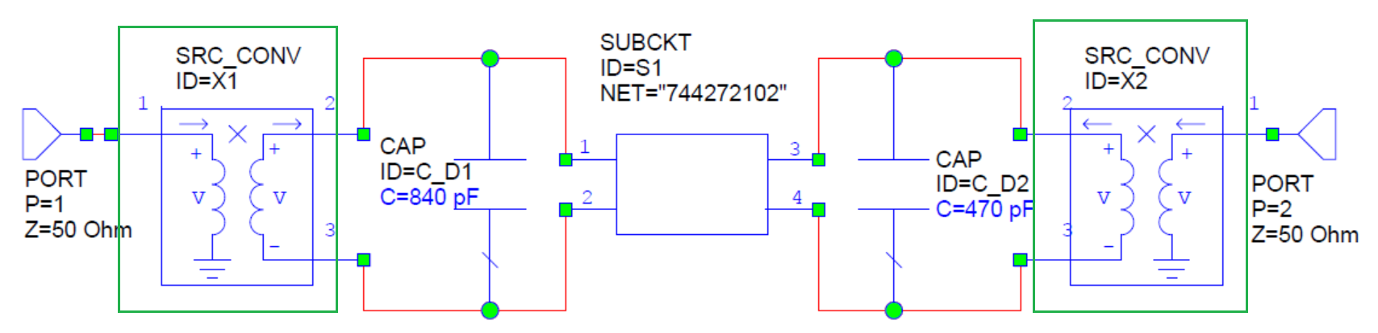
Linear Analysis
From the software circuit schematic in the following figure S-parameters can easily be determined.
Figure 11: Software design (simulated) of Common Mode Filter and Differential Mode Filter.

Slide 13
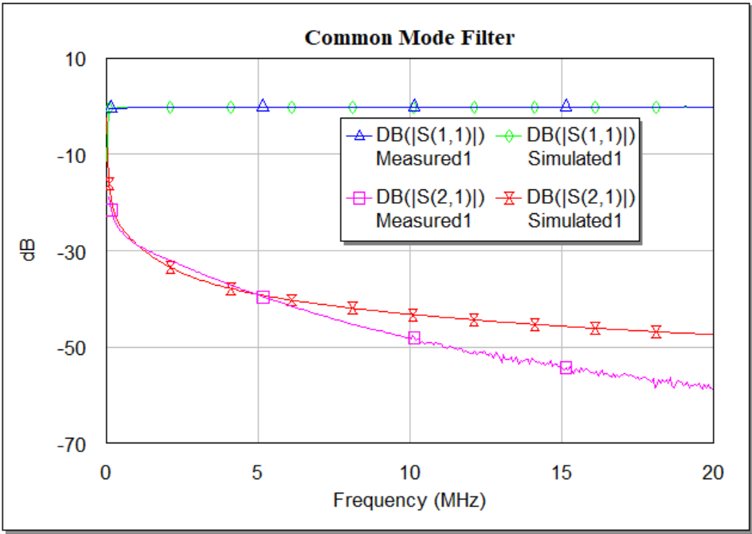
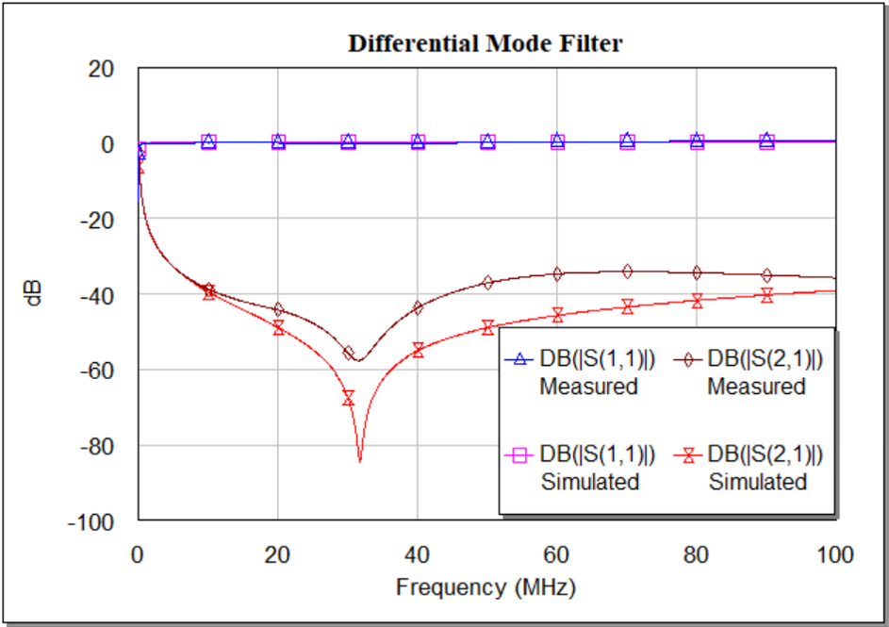
Linear Analysis
Scattering parameters measurement results for the measured (Hardware) and simulated (Software) Common mode filter and Differential Mode filter are plotted.
Figure 12: S-parameter measurement of Common Mode Filter and Differential Mode Filter.

Slide 14
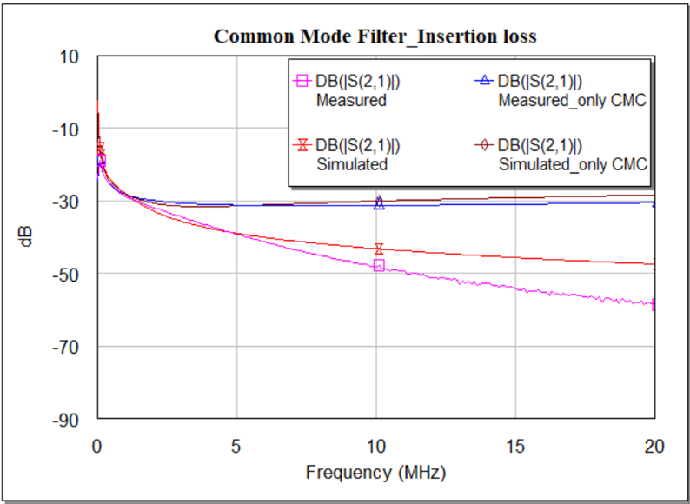
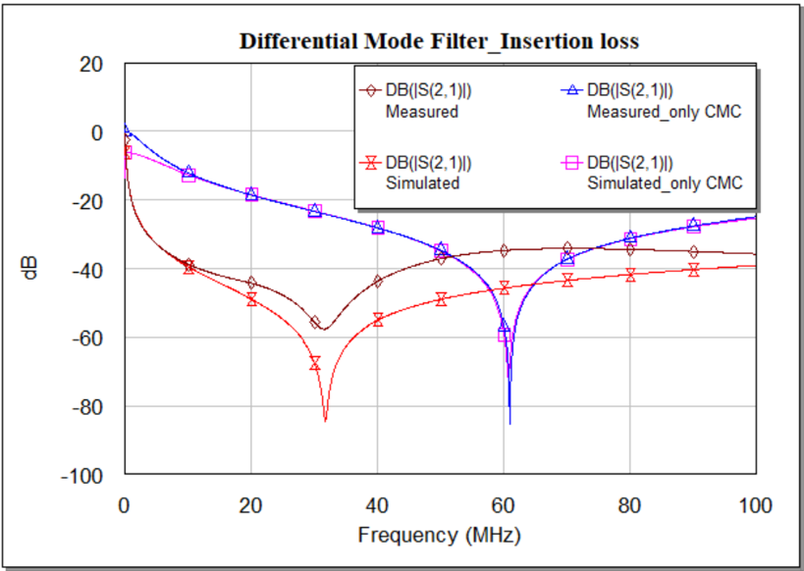
Linear Analysis
Insertion loss: It is the ratio between the output power and the input power.
Figure 13: Insertion loss measurement of Common Mode Filter and Differential Mode Filter.

Slide 15
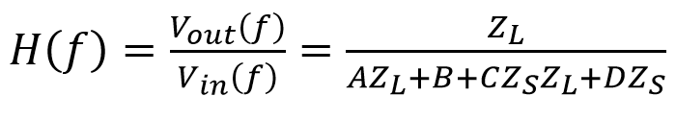
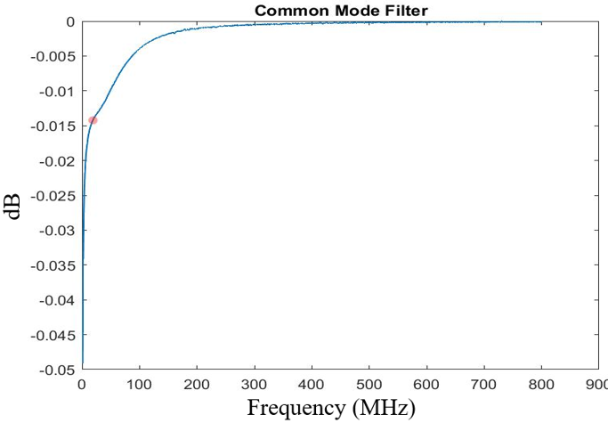
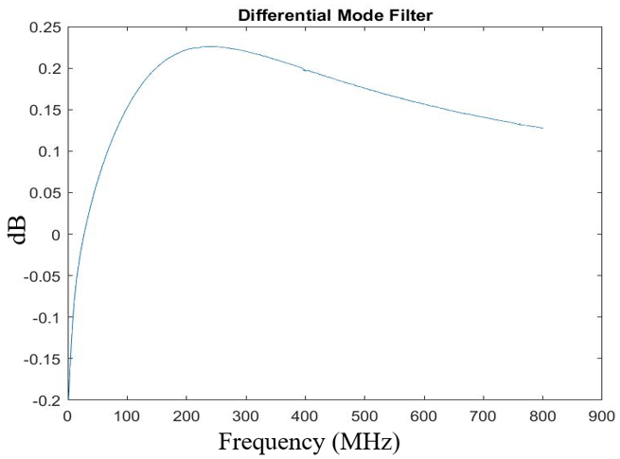
Linear Analysis
Transfer Function: A filter’s behavior consisting it’s input output relationship at a given frequency can easily estimate using the transfer function.
(1)
Figure 14: Transfer function measurement of CMF and DMF using ABCD-parameter.

Slide 16
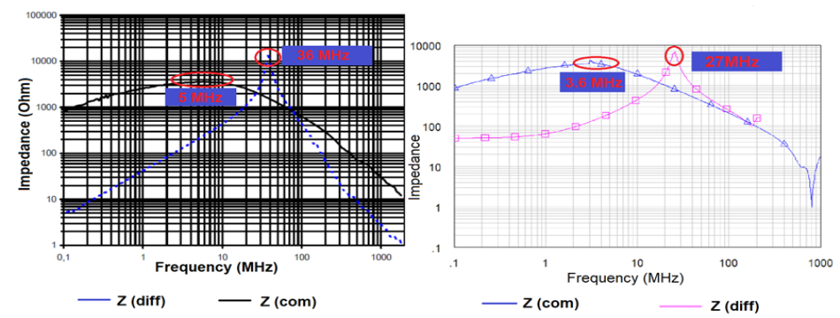
Linear Analysis- Discussion
Input Impedance has been tested for both of the measured and simulated filter.
Insertion and reflection losses for both of the measured and simulated filter are compared and estimated the differences due to the internal losses of the components.
Calculations of the Transfer function for the both of the filter are as expected.
Very close results of the measured and simulated result proves the Filter’s efficiency.
Figure 15: Impedance of a Common Mode Choke (CMC) from theory and measured results.

Slide 17
Nonlinear Analysis
Time domain analysis:
The best way to find out how a filter will work
Essential to determine signal distortion due to the non-linearity of the device
Signal value is determined of individual event for real numbers
Graph shows how a signal changes with time
Oscilloscope is used to see real signals in the time domain.
Frequency domain analysis:
Displays how much of the signal exists within a given frequency band.
Includes information of signals phase shift to recombine frequency components.
Solutions can be converted from time domain to frequency domain using Fast Fourier Transform.
Spectrum Analyzer is used to visualize electronic signals in the frequency domain.

Slide 18
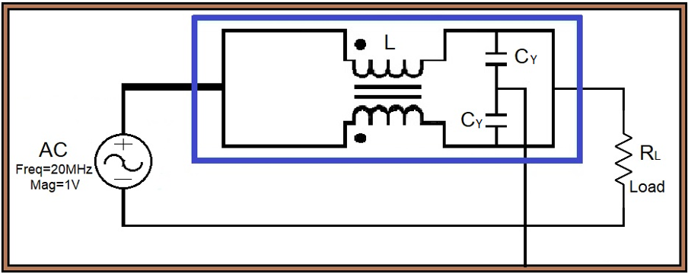
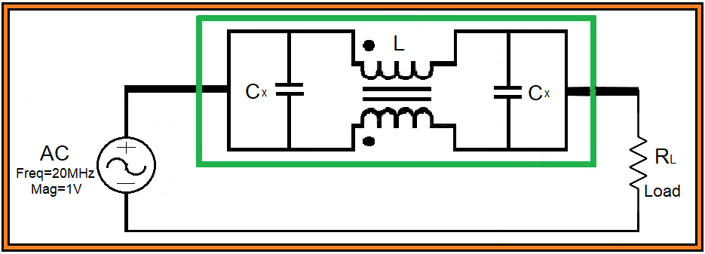
Nonlinear Analysis
It is important to design circuit of the both filters so that the analyzing becomes easier to simulate.
Figure 15: Circuit design of CMF and DMF for doing time domain and frequency domain analysis.

Slide 19
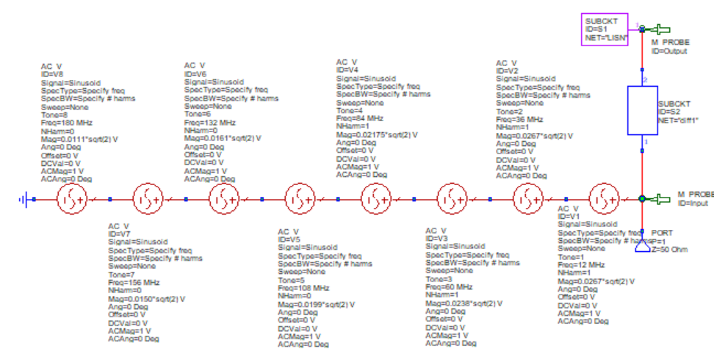
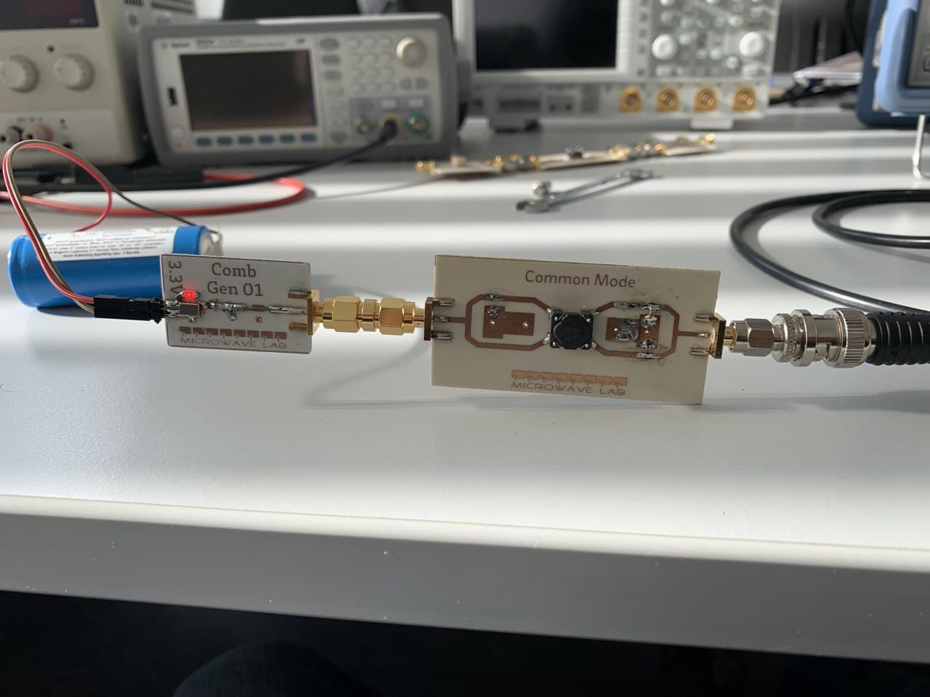
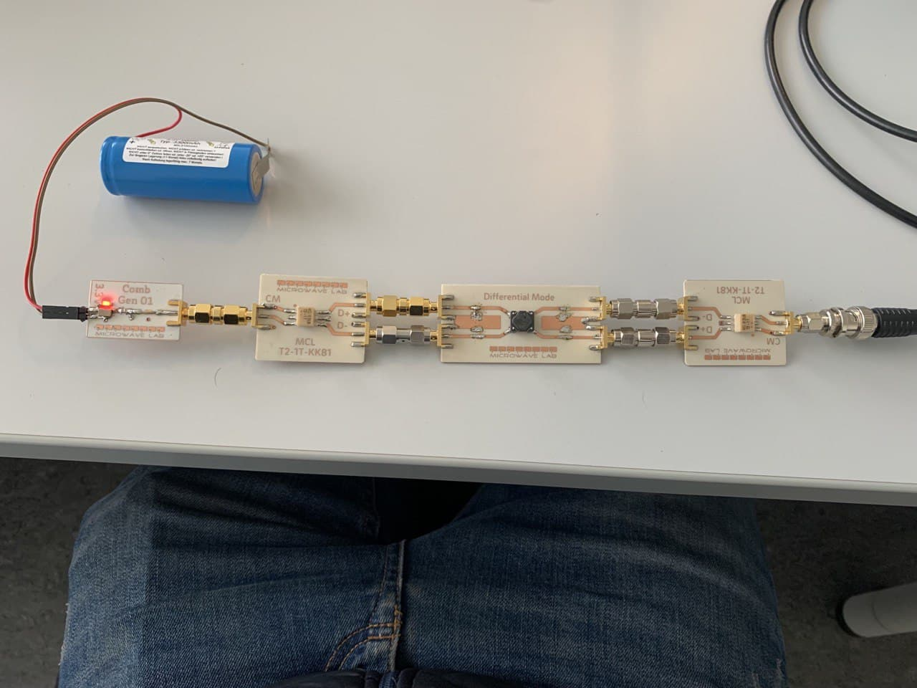
Nonlinear Analysis-Time Domain
Figure 16: Hardware and Software simulation of CMF and DMF with Comb Generator and Balun Transformer.

Slide 20
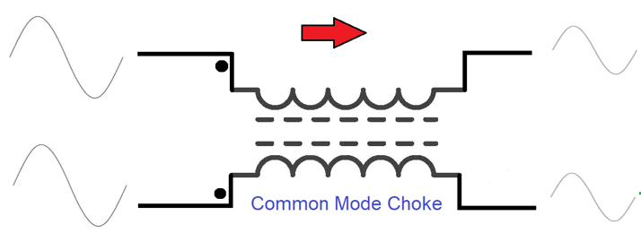
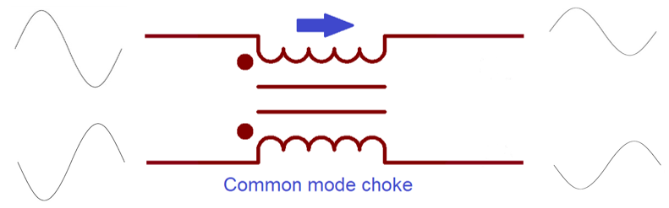
Time Domain- Discussion
For a single tone sinusoidal input signal, the measured and simulated output results are pretty similar except for the peak.
In the presence of noise the output voltage for both of the filter also results as expected.
In the time domain, the output power of measured and simulated filter gives nice and sharp transitions.
In the presence of noise, the output power indicates the good performance of the filter.
Figure 21: Expected input and output signal amplitude of a Common Mode Filter and Differential Mode Filter

Slide 21
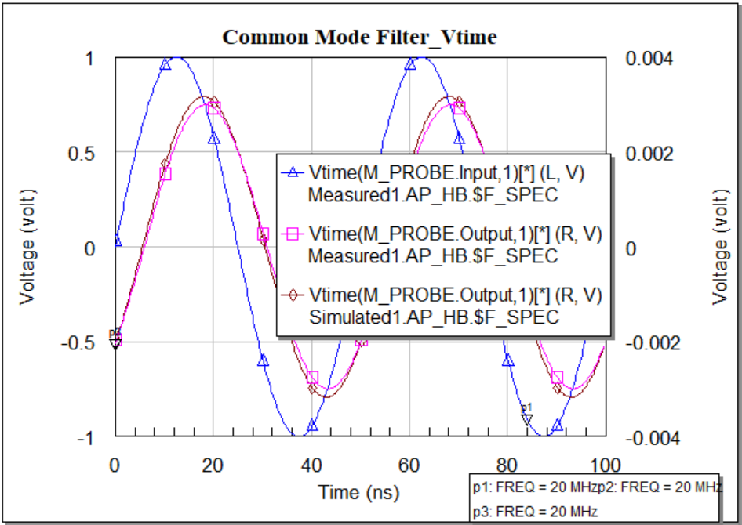
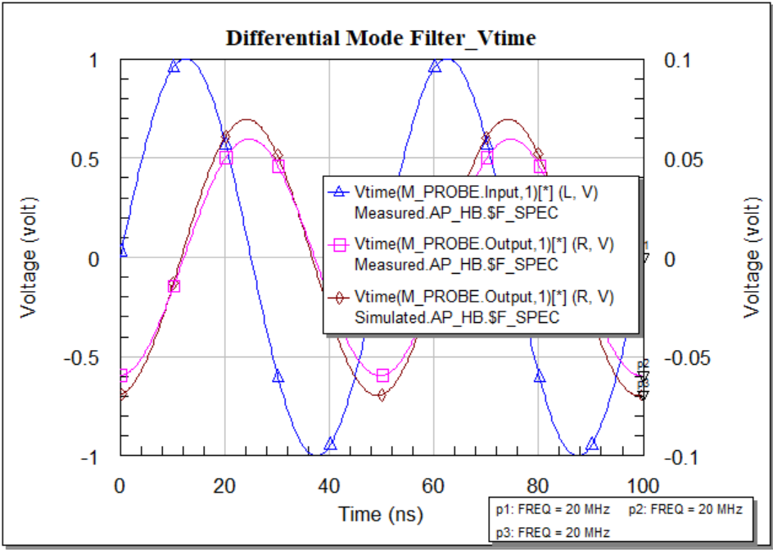
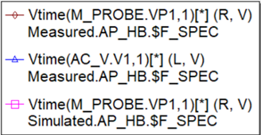
Nonlinear Analysis-Time Domain
Voltage measurements: It is essential because the input output results estimate the existence of noise in a filter. Without any noise the voltage measurements are as following:
Figure 17: CMF and DMF voltage measurement in time domain using sinusoidal signal.

Slide 22
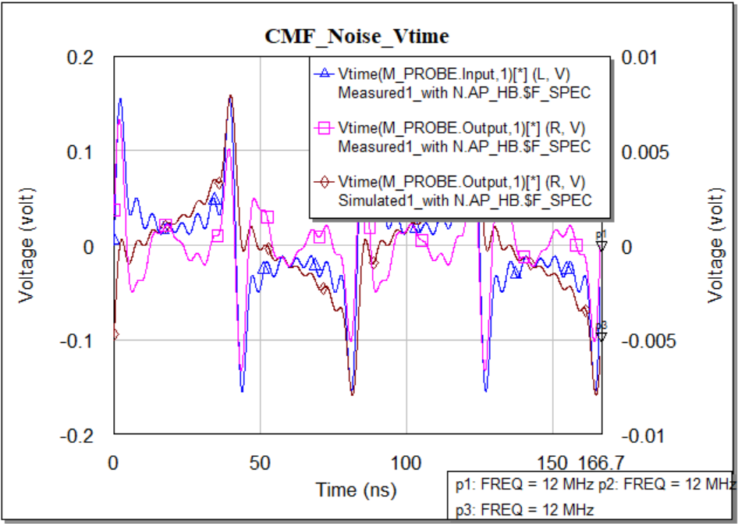
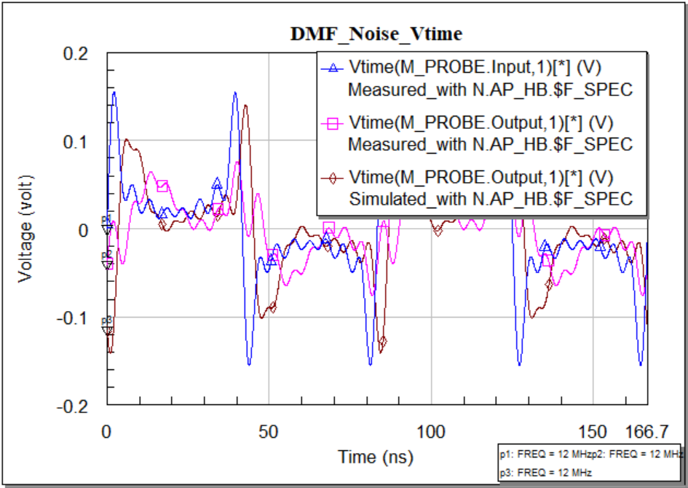
Nonlinear Analysis-Time Domain
With the involvement of noise the voltage measurements are as following:
Figure 18: CMF and DMF voltage measurement in time domain using sinusoidal noise.

Slide 23
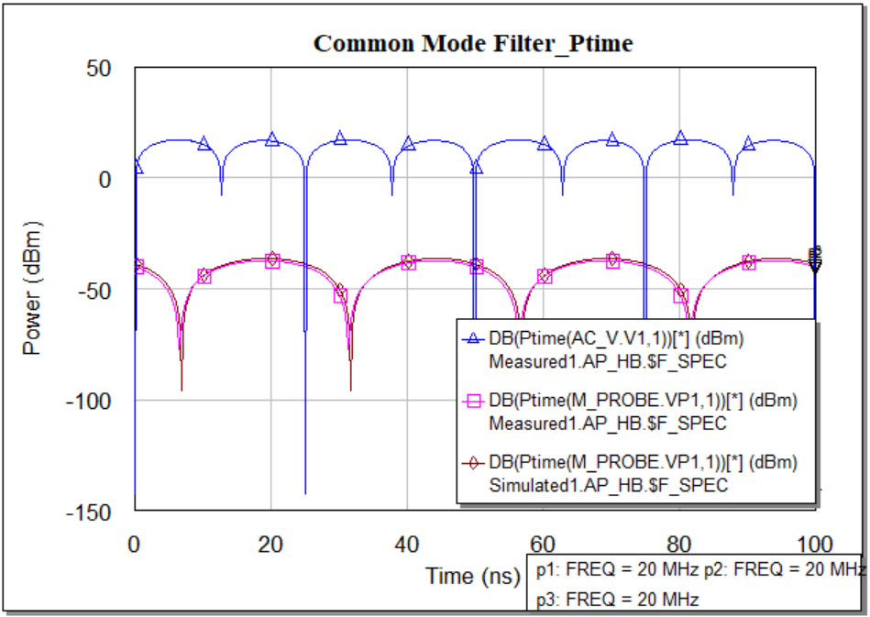
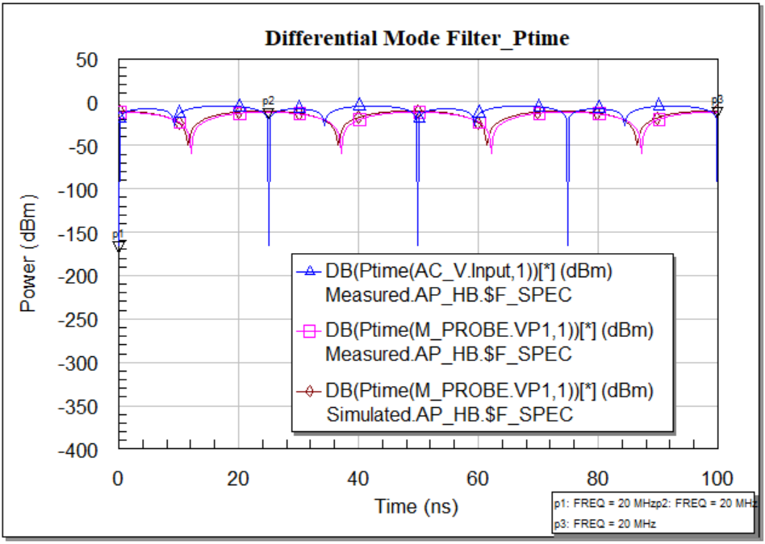
Nonlinear Analysis-Time Domain
Power measurements: It is essential because the input and output power estimates the filter quality. The simulated input output results without noise are like:
Figure 19: CMF and DMF power measurement in time domain using sinusoidal signal.

Slide 24
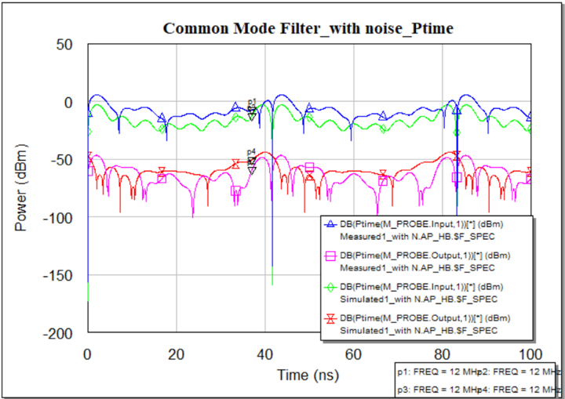
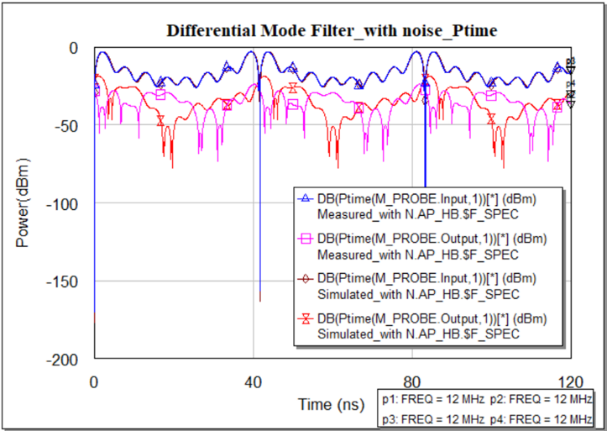
Nonlinear Analysis-Time Domain
The simulation results for measuring power with the involvement of noise are in the following:
Figure 20: CMF and DMF power measurement in time domain using sinusoidal noise.

Slide 25
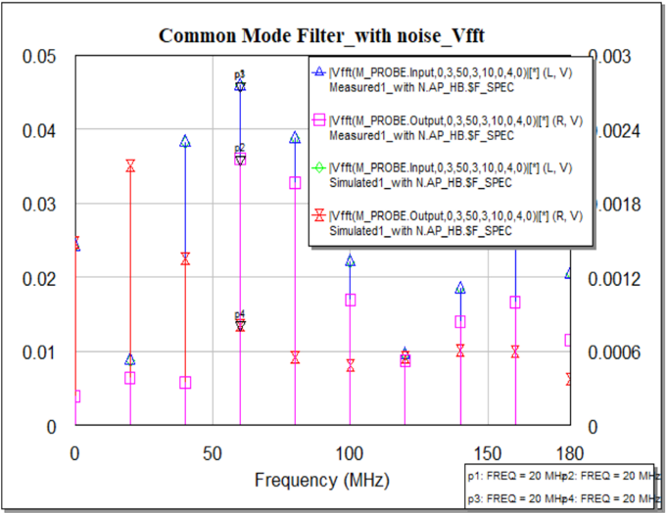
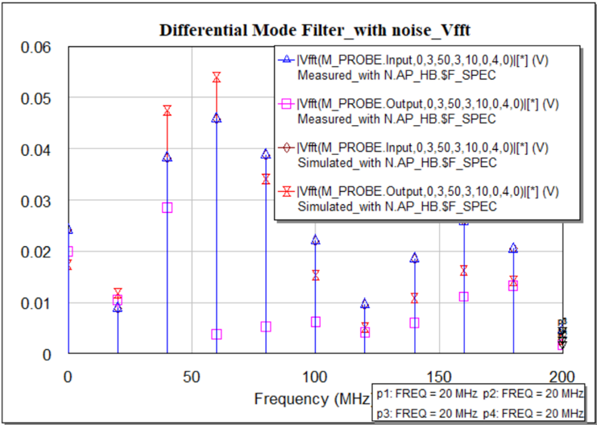
Nonlinear Analysis-Frequency Domain
Voltage measurements: It is obtained after fast furrier transform of the time domain response. The simulation results of voltage measurements having noise source is in following:
Figure 22: CMF and DMF voltage measurement in frequency domain using sinusoidal noise.

Slide 26
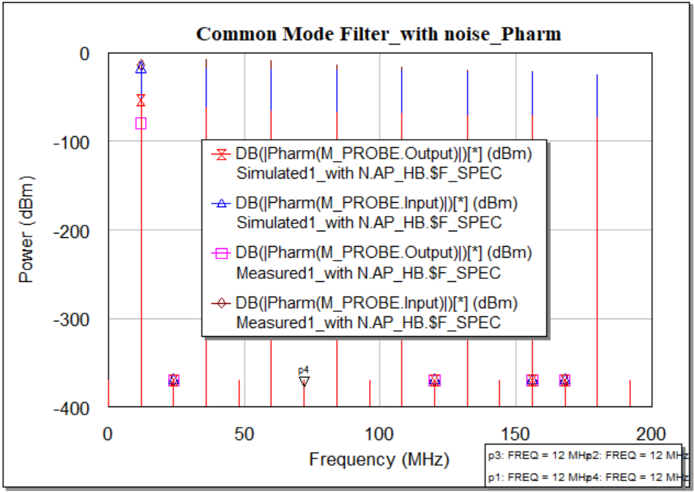
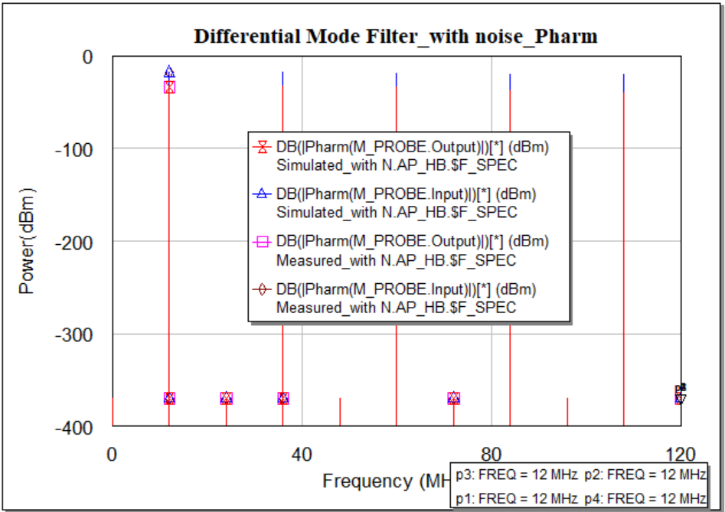
Nonlinear Analysis-Frequency Domain
Power measurements: It is essential because the harmonic output power estimates the power losses of the nonlinear system. Simulated Input and Output power for both of the filter with the noise are in followed:
Figure 23: CMF and DMF power measurement in frequency domain using sinusoidal noise.

Slide 27
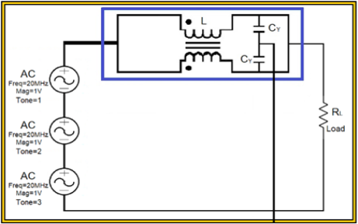
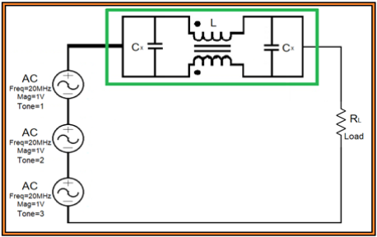
Multi-tone- Discussion
Three Sinusoidal signal sources having 1 volt and frequencies 20 MHz, 40MHz, and 100MHz respectively are used to do this test.
In the Common Mode Filter, The measured and simulated output voltage in time domain are almost matched except some drops in measured device due to real components.
For Differential Mode Filter, the amount of leakage inductance have made the magnitude and phases non matched
The sharp transitions of output power in time domain for both filters proves their better design.
Figure 28: Circuit design of CMF and DMF with multi-tone signal source.

Slide 28
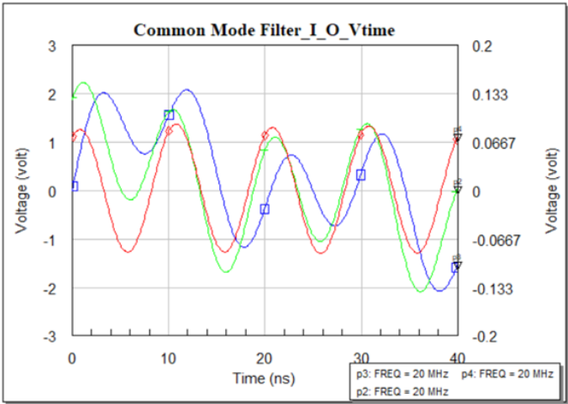
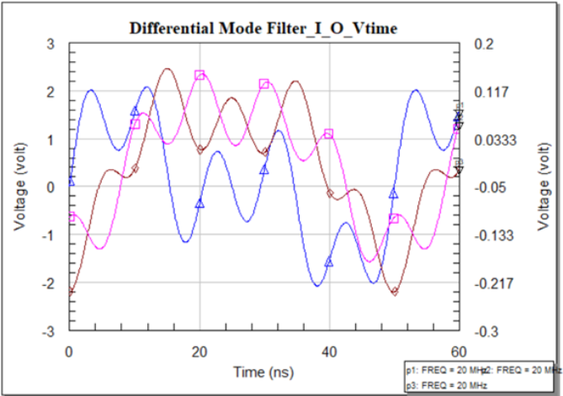


Nonlinear Analysis - Multi-tone
Voltage measurements: This simulation is completed using three sinusoidal signal source providing 1 volt of each tone and 20MHz, 40MHz, 100MHz of frequency respectively.
Figure 24: CMF and DMF voltage measurement in time domain using three sinusoidal signal.

Slide 29


Nonlinear Analysis - Multi-tone
Another voltage measurements process is done in frequency domain. Only the voltages at specific frequency will be seen in these simulated plots.
Figure 25: CMF and DMF voltage measurement in frequency domain using three sinusoidal signal.

Slide 30


Nonlinear Analysis - Multi-tone
Power measurements: It is done considering three sinusoidal source as input and at the output We have got power as follows.
Figure 26: CMF and DMF power measurement in time domain using three sinusoidal signal.

Slide 31




Nonlinear Analysis - Multi-tone
Power measurements process is done in frequency domain as harmonic power.
Figure 27: CMF and DMF power measurement in frequency domain using three sinusoidal signal.

Slide 32
New CMC- Discussion
A common mode power line choke of inductance 2.2 mH, rated voltage 250V at 50Hz is used to perform this case study.
Only my proposed sets of capacitor are used in both of the filter for this case study.
Linear and Non-linear software simulation is accomplished for this case study.
The output rating voltage for this power line choke is higher than the previously used choke.
The output power in Figure 29 shows the decent rating that proves a better designed EMI filter.

Slide 33


CASE STUDY-New CMC
New CMC Test: Another model of Common Mode Choke is used and tested the previous type simulations. CMC is designed for 230V and 50Hz is taken for the test. Simulation for the voltage measurements are done having noise in input.
Figure 29: CMF and DMF voltage measurement in time domain using sinusoidal noise signal and new CMC.

Slide 34


CASE STUDY-New CMC
Simulation for the power measurements are done having noise in input.
Figure 30: CMF and DMF power measurement in time domain using sinusoidal noise signal and new CMC.

Slide 35


USB1 cable- Discussion
The line voltage of an USB1 cable is 5 V,
For an USB1 cable, the bandwidth is 12 MHz,
Among four cables, two cables are used for power transmission as twisted pair in USB1 cable,
In Voltage measurement, for CMF one sinusoidal wave defines the higher line voltage, and for DMF, the output voltage proves the phase shift of the signal.
Multiple transitions in output power response for the CMF and DMF proves the excellent time domain response but poor frequency domain response.
Figure 33: Circuit schematic of DM filter and CM filter with USB connection.

Slide 36


CASE STUDY- USB1 cable
An USB 1 cable is considered to attend this case study. The simulated results for measuring voltage are given in the following figure.
Figure 31: CMF and DMF voltage measurement in time domain using sinusoidal noise signal with USB1 cable.

Slide 37


CASE STUDY- USB1 cable
The simulated results for measuring power are given in the following figure.
Figure 32: CMF and DMF power measurement in time domain using sinusoidal noise signal with USB1 cable.

Slide 38
Conclusion
The main goal of this thesis work was to built a filter that will attenuate the measured emissions flowing through the conductors. It is observed that the best way to reduce the conducted emissions induced, is to stop it at the entry and the exit point of a module. The attenuation capacity of our designed filter is quite better. So we can easily make this filter and can use it both in commercially or in laboratory.

Slide 39
References
[1]. A. V. S. Bhd, “ME1400 EMI AND EMC,” [Online]. Available: https://ppt-online.org/152151. [Accessed 11 October 2021].
[2]. K. A. KG, “EMC Considerations for Auxiliary Inverters in Electric Vehicles Applications,” 2021. [Online]. Available: https://www.kebamerica.com/blog/emc-considerations-in-electric-vehicle-applications/. [Accessed October 2021].
[3]. G. BOCOCK, “Match modular EMI AC line filters to application’s DC supply needs,” 28 FEBRUARY 2020. [Online]. Available: https://www.edn.com/match-modular-emi-ac-line-filters-to-applications-dc-supply-needs/. [Accessed 5 October 2021].
[4]. K. Bellero, “EMI FILTER DESIGN,” 23 May 2018. [Online]. Available: https://impulse.schaffner.com/en/engineers-guide-to-designing-emi-filter. [Accessed 1 October 2021].
[5]. C. Kathalay, A practical approach to Electromagnetic compatibility, Pune, India: EMC Publications, Pune, 2014.
[6]. C. Paul, Introduction to Electromagnetic Compatibility, John Wiley & Sons,, 1992.

Slide 40
Thank You!

